Slide 1
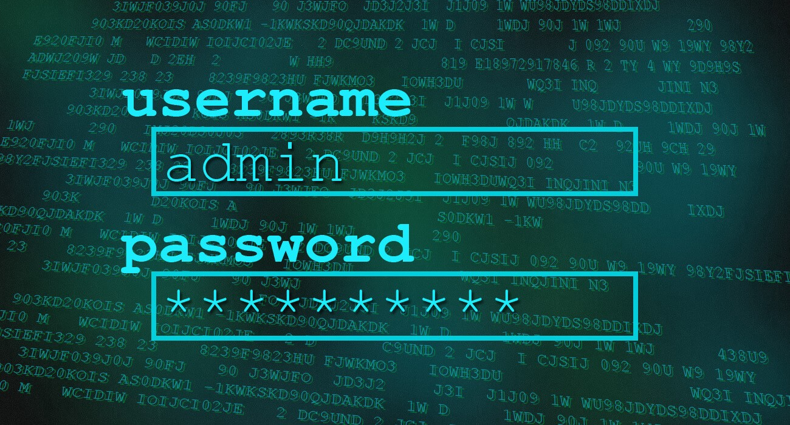
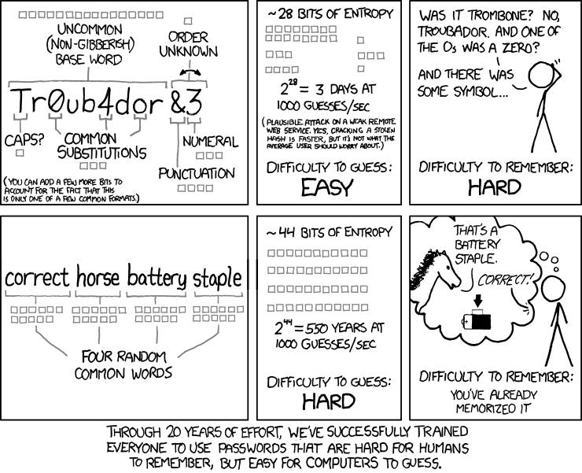
MVARC P4ssw0rd Security *(password)
Presented by Mike Sipin KA9CQL
October 14, 2021

Slide 2
Agenda*
*BTW - Feel free to ask questions at any point
Introduction – Who am I?
What are Passwords?
The Problem with Passwords...
How Humans Adapt
Hackers Adapt, Too!
Dirty-little-secrets about Passwords
What Should We Do?!
Making good passwords
One interesting idea…
Online Password Generators
Protecting your passwords
Some “Parting Advice”
Any Final Questions?

Slide 3
Who am I?
Mike Sipin, KA9CQL - Victorville, CA
ka9cql@gmail.com
Long time Ham
Professional “hacker”
Inventor of network-securty products and solutions
Invited to give this talk by Pat, N6WHZ (Thank you, Pat!)
Happy to be invited back!

Slide 4
What are passwords?

Slide 5
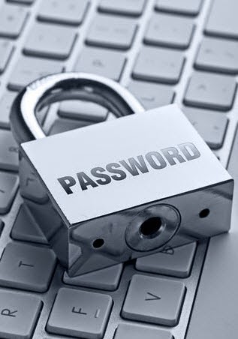
Passwords Are…
Passwords are just “electronic locks”
They give you a sense of security
Prevent “nosey neighbors” from snooping around
Help businesses prove it’s “really you”
Help keep “bad guys” out of your stuff!

Slide 6
The Problem with Passwords…

Slide 7
The Problem With Passwords…
We need too many! They’re used everywhere!
Which password goes with which account?
Good passwords are hard to remember
Complicated website password requirements
“Use capital and lower case letters, numbers, special characters… at least three groups, no more than two in a row from any one group, blah blah blah - OMG, SERIOUSLY!?
Just when you get a “good one”, you are forced to change it!
Every few months (company policy)
Every time there is a data breach (or even “suspected breach” – they rarely admit it!)
Make you change it “out of an abundance of caution”. (If they used an “abundance of caution” in the first place, there wouldn’t be a breach, am I right?)
We forget them so often, every website has a “Forgot your password?” link!
…so, we “set it and forget it™!”

Slide 8
How Humans Adapt

Slide 9
How Humans Adapt
(Because passwords are needed everywhere) We tend to reuse the same one!
Problem: If just one of those websites gets hacked, there goes all your security!
(Because they’re hard to remember) We tend to use “mental shortcuts”
Popular “shortcuts” –
Birthdays, street addresses, telephone numbers
Spouse/child/grandchild/pet’s names
Common words, phrases, quotes – “password”, “monkey”, “changeme”, “qwerty”, etc.
Favorite people, movies, brand names, cities, sports teams (“DaBears” is actually popular!)
Use numbers to replace vowels (e.g. “password” becomes “p4ssw0rd”)
Add a few numbers to the end of a common word – “password123”, “admin1234”
And combinations of the above
“Spring2021”, “Summer2021!,” “Jenny8675309”
“Mexico1984”, “1l0v3y0u!”

Slide 10
Hackers Adapt, Too!

Slide 11
Hackers Adapt, Too!
Bad guys know we take “mental shortcuts”!
They use every known combination of these shortcuts to build password lists
Use machine learning to predict human behaviors, and develop new patterns
Hackers steal passwords from websites
Use them directly, as part of “password spray” attacks
Use them to try and figure out common patterns to add to their cracking tools
Download password lists from the Internet
https://github.com/danielmiessler/SecLists/tree/master/Passwords
https://weakpass.com/wordlist
https://gist.github.com/roycewilliams/226886fd01572964e1431ac8afc999ce
…and many more…
All of these techniques are used to try to figure out your passwords!

Slide 12
Dirty-little-secrets about Passwords

Slide 13
Dirty-little-secrets about Passwords
Easy-to-remember usually means easy-to-crack! (We’ll fix this in a bit…)
Estimated time to crack a simple, 11-character mixed letters/numbers password –
https://password.kaspersky.com/ - Instantly (CORRECT!)
https://www.generateit.net/password-strength-tester/ - less than 1 second (CORRECT!)
https://bitwarden.com/password-strength/ - 7 hours (Wrong – false sense of security!)
https://www.passwordmonster.com/ - 31 hours (Really wrong)
https://random-ize.com/how-long-to-hack-pass/ - 7,527,508 years and 7 months (Really, totally and COMPLETELY wrong!)
If these websites say it’s easy to crack your password, BELIEVE IT!
Check each of the above websites, and use the quickest time-to-crack you get – it’s likely correct!
Hacker Tricks
They know our “password shortcuts” (covered earlier)
They know about password lists, too
https://github.com/danielmiessler/SecLists/tree/master/Passwords
https://weakpass.com/wordlist
…and others, from earlier…
They use both to try to figure out your passwords!

Slide 14
Dirty-little-secrets about Passwords
Easy-to-remember usually means easy-to-crack! (We’ll fix this in a bit…)
Estimated time to crack a simple, 11-character mixed letters/numbers password –
https://password.kaspersky.com/ - Instantly (CORRECT!)
https://www.generateit.net/password-strength-tester/ - less than 1 second (CORRECT!)
https://bitwarden.com/password-strength/ - 7 hours (Wrong – false sense of security!)
https://www.passwordmonster.com/ - 31 hours (Really wrong)
https://random-ize.com/how-long-to-hack-pass/ - 7,527,508 years and 7 months (Really, totally and COMPLETELY wrong!)
If these websites say it’s easy to crack your password, BELIEVE IT!
Check each of the above websites, and use the quickest time-to-crack you get – it’s likely correct!
Hacker Tricks
They know our “password shortcuts” (covered earlier)
They know about password lists, too
https://github.com/danielmiessler/SecLists/tree/master/Passwords
https://weakpass.com/wordlist
…and others, from earlier…
They use both to try to figure out your passwords!
Live DEMO

Slide 15
Dirty-little-secrets about Passwords
Easy-to-remember usually means easy-to-crack! (We’ll fix this in a bit…)
Estimated time to crack a simple, 11-character mixed letters/numbers password –
https://password.kaspersky.com/ - Instantly (CORRECT!)
https://www.generateit.net/password-strength-tester/ - less than 1 second (CORRECT!)
https://bitwarden.com/password-strength/ - 7 hours (Wrong – false sense of security!)
https://www.passwordmonster.com/ - 31 hours (Really wrong)
https://random-ize.com/how-long-to-hack-pass/ - 7,527,508 years and 7 months (Really, totally and COMPLETELY wrong!)
If these websites say it’s easy to crack your password, BELIEVE IT!
Check each of the above websites, and use the quickest time-to-crack you get – it’s likely correct!
Hacker Tricks
They know our “password shortcuts” (covered earlier)
They know about password lists, too
https://github.com/danielmiessler/SecLists/tree/master/Passwords
https://weakpass.com/wordlist
…and others, from earlier…
They use both to try to figure out your passwords!

Slide 16
More “dirty-little-secrets”…
If “passwords are just electronic locks”, computers are “electronic locksmiths”
Hackers can hire a “password locksmith”
Can use online services –
Free – Internet based: “submit-and-wait” (usually less than 5 minutes)
Paid – Legitimate tools and websites (very few; be very careful!)
Paid – “Underground” services (far more dangerous – and far more likely to succeed!)
Anyone can become a “password locksmith” (aka “hacker”)
“john the ripper”, “Hashcat” – free password-cracking tools
Kali Linux, Security Onion, Pentoo – bootable Linux images pre-configured with website and password hacking/cracking tools
Amazon Web Services (AWS) can be used to crack passwords, too!
Graphics cards (GPUs) work great as password crackers, too!
https://medium.com/hackernoon/20-hours-18-and-11-million-passwords-cracked-c4513f61fdb1
In short, it’s easy to take advantage of anyone that uses a “bad” password!

Slide 17
What Should You Do?

Slide 18
What Should You Do?
See if your password was already stolen/cracked. If so, change it!!
Check your password on Troy Hunt’s website (“Have I been pwned?”)
https://haveibeenpwned.com/Passwords
613,584,246 real world passwords (as of this writing, and always growing!)
Don’t use a “popular”/”well-known” or already-compromised password
https://nordpass.com/most-common-passwords-list/
https://en.wikipedia.org/wiki/Wikipedia:10,000_most_common_passwords
Check online password lists mentioned earlier – if you find yours in there, DON’T USE IT!
Don’t use a “bad” password
“Short is bad”
“Simple is bad” (*But there’s hope coming in a minute…)
Using predictable/common “shortcuts” is bad
“Can you help me?” – ABSOLUTELY!

Slide 19
Making Good Passwords
Longer is not always better!
Longer-but-common (bad)
Longer-but-uncommon (better)
Password-helpers
https://lastpass.com/howsecure.php - Simple, clear advice
https://www.generateit.net/password-strength-tester/ - Has “traditional” advice (plus an estimate of time-to-crack)
https://www.uic.edu/apps/strong-password/ - To really “geek out!”
http://www.passwordmeter.com/ - Another “total geek-out” site

Slide 20
Making Good Passwords
Longer is not always better!
Longer-but-common (bad)
Longer-but-uncommon (better)
Password-helpers
https://lastpass.com/howsecure.php - Simple, clear advice
https://www.generateit.net/password-strength-tester/ - Has “traditional” advice (plus an estimate of time-to-crack)
https://www.uic.edu/apps/strong-password/ - To really “geek out!”
http://www.passwordmeter.com/ - Another “total geek-out” site
Live DEMO

Slide 21
Passwords the “Menifee Mensch” Way!
Long-but-”simple” (avoiding shortcuts!)
“Since1960-MyFavoriteTeam?Dodgers!”
“I-married-Janet-on-June-14th”
“Who’sMyWifeOf30+Years?Francine!”
“IAm6Foot3And180#WithBlueEyes”
“Katie_Tom_Bruce_Carol_And_11_Grandkids!”
“I+h8+rutabaga+September+1972”
“Mac1-n2-Cheese3-is4-da5-bomb6!”
“1L0v3H4mR4d10$ka9cql”
“MyDog=Spot;Aol.com@2021”*
All of the above are long, easy/easier to remember, and very complex (read: HARD FOR COMPUTERS TO CRACK!)
*That last password “MyDog…” has a website in it – change that for each website, and it’ll be obvious what password goes with which account/website!

Slide 22
Online Password Generators
There are websites that will create strong passwords for you!
Might not be easy-to-remember them, but they will be very secure!
Use reputable sites… don’t “just google it”
https://www.lastpass.com/features/password-generator - Strong, reputable
https://nordpass.com/password-generator/ - Strong, reputable
https://www.expressvpn.com/password-generator - Complex, but secure
https://my.norton.com/extspa/passwordmanager?path=pwd-gen - A little too complex, for me…
https://1password.com/password-generator/ - Also “a bit much”
Steve Gibson’s password generator
For the “criminally-insane”/ultra-paranoid among us!
https://www.grc.com/passwords.htm

Slide 23
Protecting Your Passwords
Write them down, and lock them away (this was mentioned before)
Use a “password keeper”
1Password - https://1password.com/
LastPass - https://www.lastpass.com/ - Caution: They have had issues… (see: https://en.wikipedia.org/wiki/LastPass#Security_issues)
What about a hardware device/dongle?
YubiKey - https://www.yubico.com/why-yubico/how-the-yubikey-works/
Google “Titan Security Key” - https://cloud.google.com/titan-security-key
RSA Key fob (some banks offer these – Wells Fargo, for sure!) - https://www.rsa.com/en-us/store
A word about using your Facebook/Google login on other sites…
Same problem as using a single password everywhere –
If hackers crack that one password, there goes all your security!

Slide 24
Parting Advice

Slide 25
Parting Advice (1st of 4)
Change your passwords as you go
Hit that “forgot my password” link
Use good/stronger/”Menifee Mensch” passwords everywhere
Never (EVER!) reuse a password!
Write them all down, if you have to, and lock that list in a drawer, file cabinet, safe deposit box (etc.)
Stronger-but-written-down is better than easily-crackable by some hacker in Brazil!
Keep your new passwords secret!
Don’t give them to anyone!
Nobody over the phone
Nobody over the Internet
Never type it into an email/email reply
Never click any link found within an email – even if you think that email is legitimate!
Instead, open a private web browser tab and type in the well-known address yourself
I hate to say it, but this even goes for “forgot my password” emails

Slide 26
Parting Advice (2nd of 4)
Keep your new passwords secret, continued…
Don’t give them to anyone, continued…
NO bank, NO website and NO technical support will ever ask you for your password over the phone or in an email. P-E-R-I-O-D.
All verbal/emailed/etc. requests for your password are from hackers!
If you didn’t type in a website address yourself, treat it like it’s part of a (possibly elaborate) scam!
Hackers are even better “salesmen” than that car dealer down the street
Remember – with almost 5 BILLION people on the Internet, surely at least one of them is a hacker that is more clever than you imagine!

Slide 27
Parting Advice (3rd of 4)
Buy a new Wi-Fi router (KEEP the old one, too – you’ll see why in a second)
Plan to spend between $79 and $129 for a good-ish one
Pick a well-known vendor (no “Buffalo” or Walmart/Staples/Best Buy “private label” brand!)
CHANGE ITS DEFAULT ADMIN PASSWORD! (OMG, seriously!?)
Make your new device’s WI-Fi password strong
Make it truly random, long, and write it down
Internet-based hackers aren’t going to invade your home looking for your password log! (LOL)
Cleaning lady better be trusted, anyway!
If it’s a cleaning crew, however – lock it in a drawer, file cabinet, safe, etc.
Place new device after your current one
Internet provider modem then your old Wi-Fi device then your new Wi-Fi device = GOOD SECURITY!

Slide 28
Parting Advice (4th of 4)
Buy a new Wi-Fi router, continued…
Stop using current (“old”) router for anything except “IoT devices” –
Smart thermostats, Ring doorbells, Alexa/Google devices, security alarms, etc.
Don’t have to get too hung up about how strong the old device’s password is…
You shouldn’t trust these IoT devices, anyway!
…but change it, if you can (if pain is too great, it’s ok, and understandable)
And finally…. “Just because you’re paranoid, it doesn’t mean they’re not after you!”

Slide 29
Any Final Questions?

Slide 30
Thank you,
MVARC!
Mike Sipin, KA9CQL
ka9cql@gmail.com

Slide 31
Backup Slides Follow…

Slide 32
How Humans Adapt (2nd of 3)
(Because websites have reset-password links) We just hit the link!
Reset-link is sent via email or text message (SMS)
Problem: Email isn’t secure
Anyone that wants to can read it as it passes along
China, other governments (China, India and hackers routinely, “accidentally” redirect Internet traffic…)
Google “BGP hijacking incidents” – Thousands of hijacks per year!
Your ISP and free email provider can read it (Google – I’m looking at you!)
Any company/service/service-provider between the sender and you can read it, too!
…of course, that includes hackers
So many ways to attack the Internet….
Man-in-the-middle, phishing, click-bait, DNS poisoning
Paid/malicious company insider
Public Wi-Fi is “suspect” (“sus”, for you young whipper-snappers!)
Recommendation: Use a VPN!
DID YOU REUSE THAT WEBSITE PASSWORD ON YOUR EMAIL ACCOUNT!?!?!?!?!

Slide 33
How Humans Adapt (3rd of 3)
Problem: Two-Factor Authentication (2FA) isn’t totally/always secure
Overwhelming majority of 2FA utilizes email, text messaging or a phone call to your cellphone
These are the “second factor” – (“first factor” is your password, which, you forgot!)
By now, criminals already know (virtually) everyone’s email address and cellphone number
Way too many sources of this information, including hacks/data breaches, Internet tracking/marketing companies, 3rd party information aggregators and even credit reporting agencies! (Yep, you read that correctly!)
Google freely admits that they read all your emails (they say it is “to provide you products and services”… yeah, right!) – and they sell data about you to others
Your cellphone company sells your information – including your location information!
And, of course, social media companies are notorious for how much of your information they collect and sell to 3rd parties! (Facebook makes BILLIONS from this!)
Hackers can attack/overcome 2FA, too! (More on this in a moment…)

Slide 34
Your phone might get hacked first
“SIM Swapping” attack – Takes over your cellphone account!
Simple to do – some US carriers are working on making this harder
Gives hackers the ability to briefly intercept your cellphone calls and text messages
…which, of course, are two of the Two-Factor Authentication mechanisms!

Slide 35
Your account might get hacked, directly
Many hacking techniques can be used against your accounts
“Brute-forcing” (keep guessing passwords until one gets them in!)
“Password spraying” (try the most popular passwords on every website)
Correctly answer your “Security Questions” (using your social media posts!)
Compromise the website, steal the password database, crack it offline!
Lock you out of your account on purpose, to make you use your 2FA (which they then intercept - covered in another slide)

Slide 36
You might get hacked - “Social Engineering”
Scammers call or email you, pretending to be your bank/etc.
Over the phone – They talk you into revealing information that lets them get into your account
They may even trigger a text-message or email from your real account/website, then ask you to read it back to them “for verification purposes”
THIS WOULD CONSTITUTE A “LIVE” ATTACK!
Within an email – They get you to click on a link in the email
The link takes you to their fake website
Looks just like the real website
They trick you into typing your real password into their fake website
Now they have your password!

Slide 37
More “dirty-little-secrets”…
Hacker “shortcuts”, continued…
Cracking just one password from a website “unsalts” the rest!
Highly technical, but if you hear “salt”/”salted” with regard to passwords, understand that this can be reversed/defeated
Amazon Web Services (AWS) can be used to crack passwords, too!
Graphics cards (GPUs) aren’t just for cryptocurrency mining…
They work as password crackers, too!
https://medium.com/hackernoon/20-hours-18-and-11-million-passwords-cracked-c4513f61fdb1
If “passwords are just electronic locks”, computers are “electronic locksmiths”
Hiring a locksmith is easy (even 24/7/365!)
Hiring a “password locksmith” is easy, too
Most-popular-password lists are online (covered earlier)
Can use online services – submit a “hashed” password, wait a bit…
Uses “Rainbow Tables” – Pre-computed lists of hashes and their corresponding plain-text passwords – to spit out the password in seconds!

Slide 38
Final “dirty-little-secrets”…
Hiring a “password locksmith”, continued…
Be-your-own “locksmith”
“john the ripper”, “Hashcat” – free password-cracking tools
Kali Linux, Security Onion, Pentoo – bootable Linux images pre-configured with website and password hacking/cracking tools
Cracking-as-a-Service
Free – Internet based: “submit-and-wait” (usually less than 5 minutes)
Paid – Legitimate tools and websites (very few; be very careful!)
Paid – “Underground” services (far more dangerous!)
(I wouldn’t, if I were you…)

Slide 39
What about Two-Factor Authentication?
You usually have to turn it on (it’s not on by default… yet)
Most “larger”/”mainstream”/popular websites offer it
Is good…ish… I suppose… until it isn’t…
Just make sure YOU TRIGGERED IT, and not a hacker!
Don’t ever tell someone who called you what is in a Two-Factor Authentication email or text message!!
Only tell someone that you called, and even then, only if you dialed a number you already knew or obtained from a “trusted source” (e.g. bank/credit card statement, bill or receipt, etc.) NEVER TRUST AN EMAILED LINK!

Slide 40
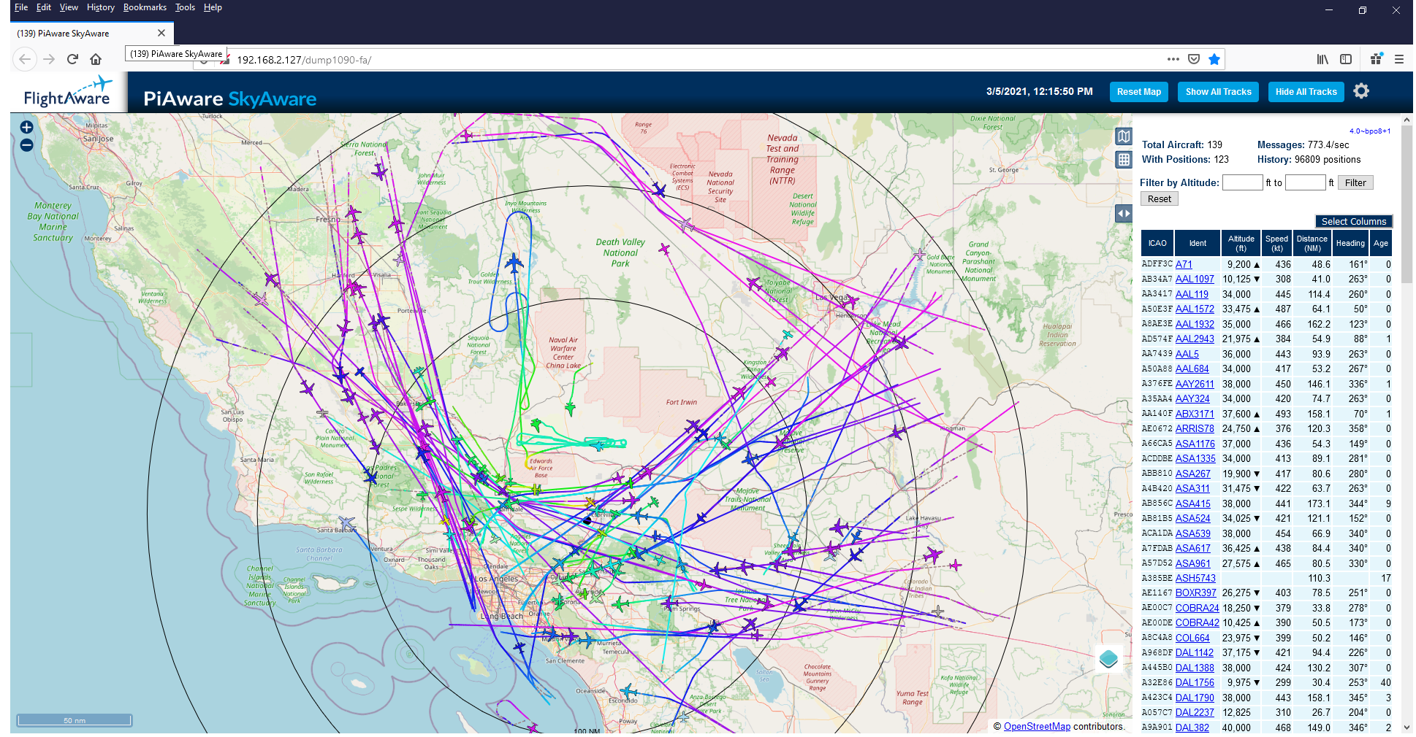
Live DEMO

